Slide 1
What’s Wrong With Nearest Neighbors?
Are Parametric Models
Good or Bad?
(Ans: yes!)

Slide 2

Image Space vs Feature Space
Convolutional Neural Net (CNN) as encorder of features:
“Quick” visualization of 2D Convolution
Example of what filters are looking for

Slide 3
Computer vision: models, learning and inference
Chapter 3
Common probability distributions

Slide 4

Image by Razzu Engen: http://www.flickr.com/photos/razzumitos/5113099674/

Slide 5
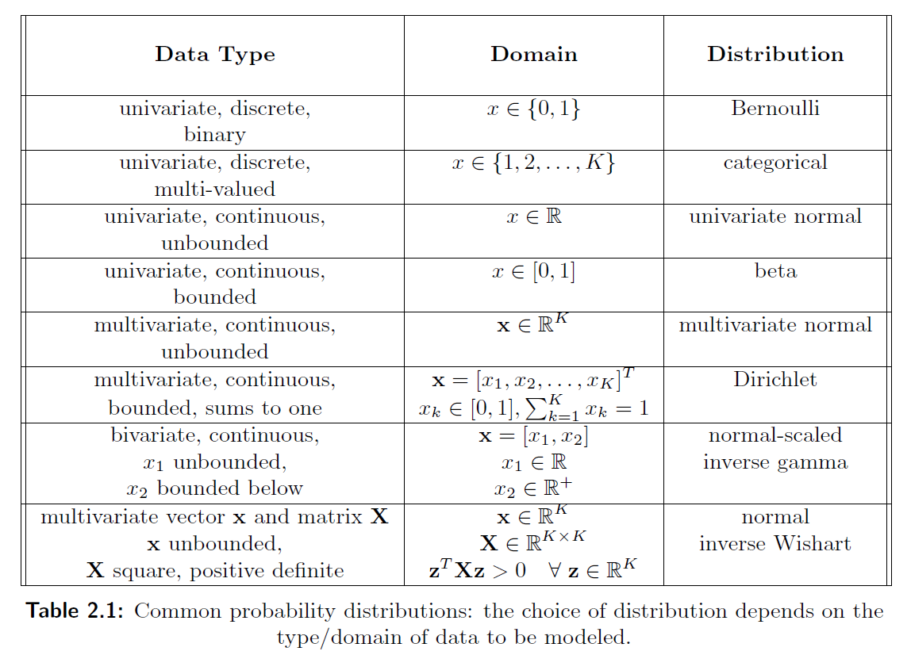

Slide 6
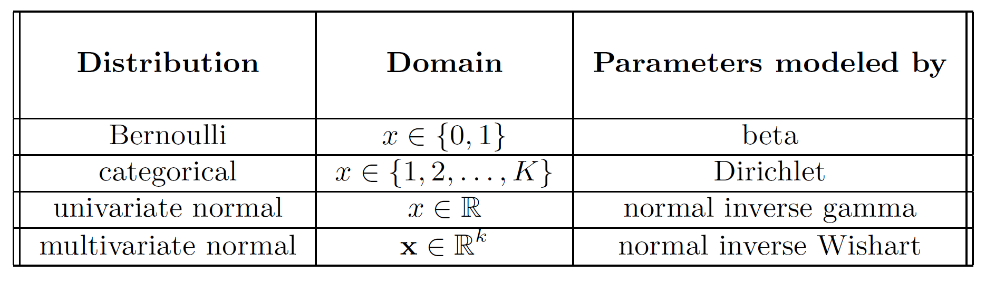
Why model these complicated quantities?
Because we need probability distributions over model parameters as well as over data and world state. Hence, some of the distributions describe the parameters of the others:

Slide 7
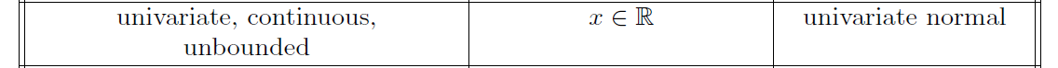
Why model these complicated quantities?
Because we need probability distributions over model parameters as well as over data and world state. Hence, some of the distributions describe the parameters of the others:
Example:
Parameters modelled by:
Models variance
Models mean

Slide 8
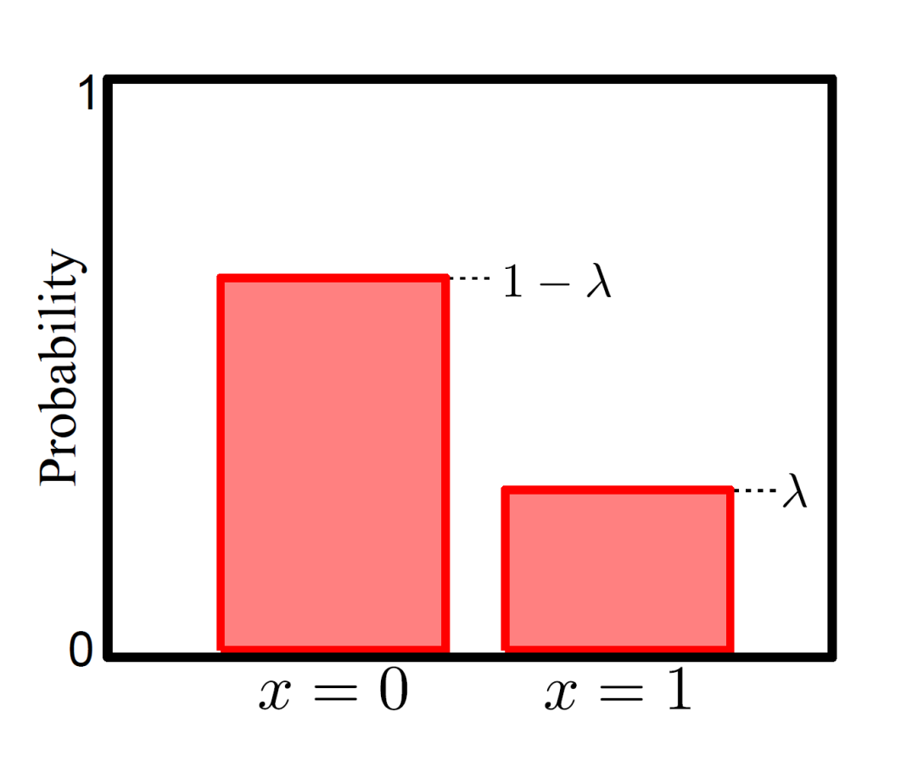
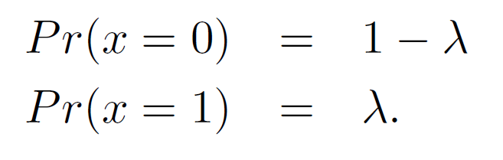

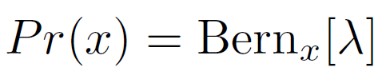

Bernoulli Distribution
or
For short, we write:
Bernoulli distribution describes situation where only two possible outcomes y=0/y=1 or failure/success
Takes a single parameter

Slide 9
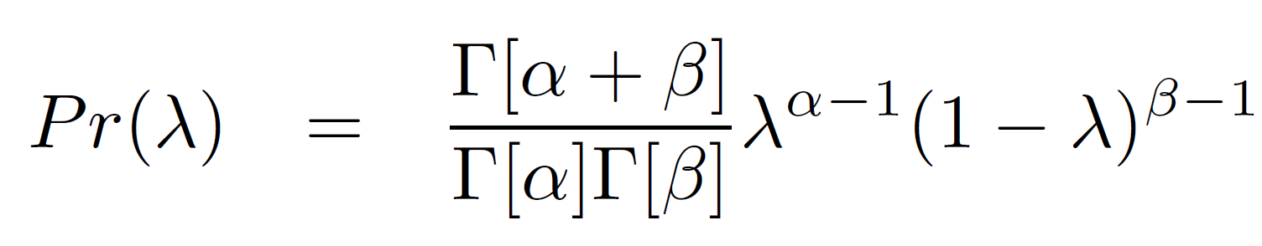
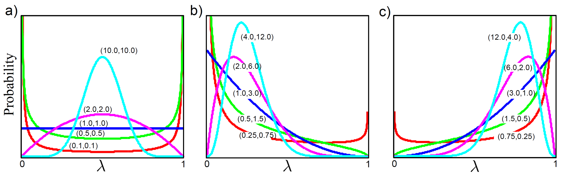
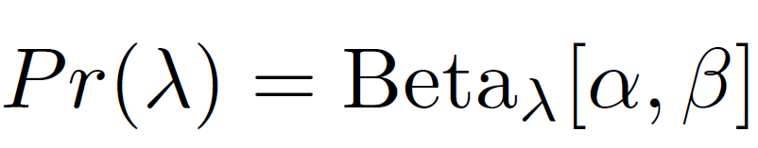
Beta Distribution
Defined over data (i.e. parameter of Bernoulli)
Two parameters α,β both > 0
Mean depends on relative values E[λ] = α/(α+β).
Concentration depends on magnitude
For short, we write:

Slide 10
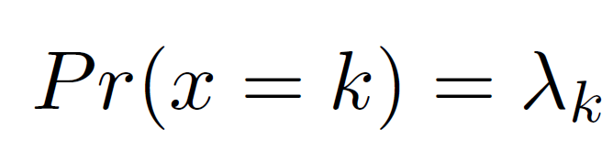
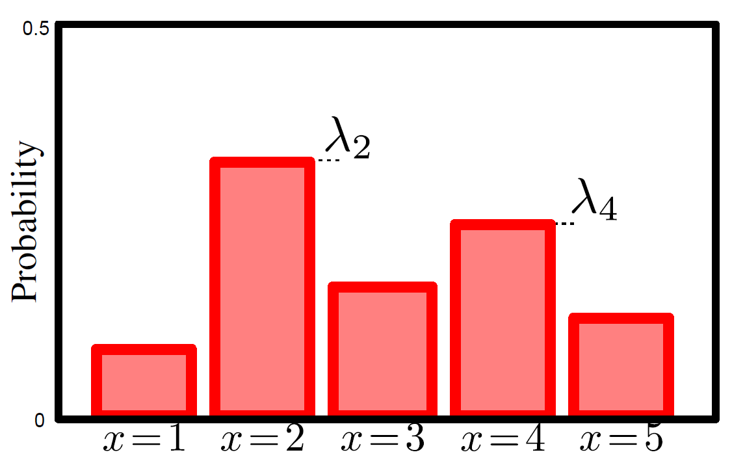
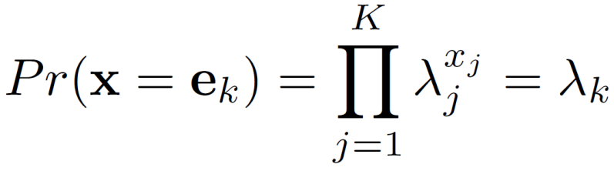
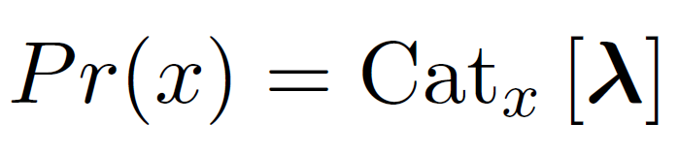
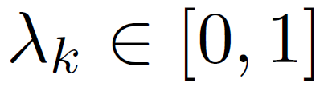
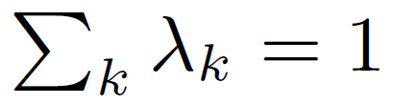
Categorical Distribution
or can think of data as unit-vector with all elements zero except k^{th} e.g. e₄ = [0,0,0,1,0]
(so x_{j} is the j^{th} element of x, i.e. a 0 or 1)
For short we write:
Categorical distribution describes situation with K possible outcomes y=1… y=k.
Takes K parameters where

Slide 11
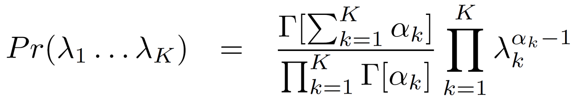
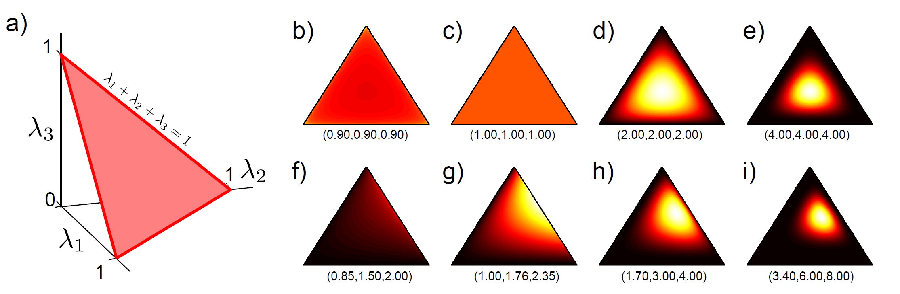
Dirichlet Distribution
Defined over K values where
Or for short:
Has k
parameters α_{k}>0

Slide 12
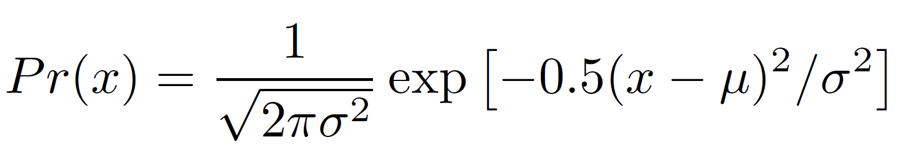
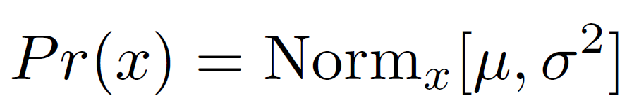
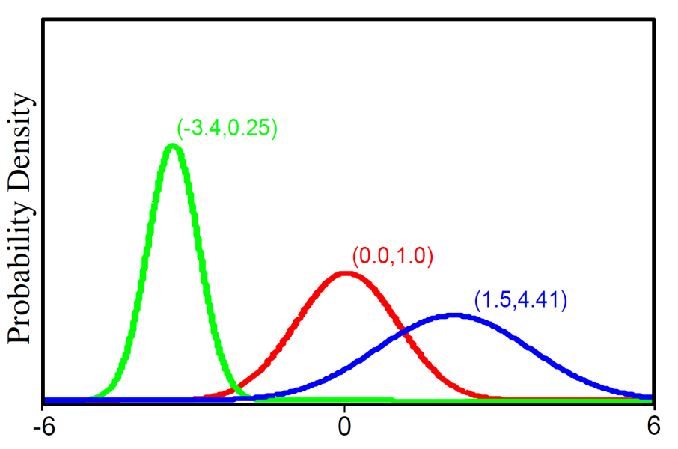
Univariate Normal Distribution
For short we write:
Univariate normal distribution describes single continuous variable.
Takes 2 parameters μ and σ²>0

Slide 13
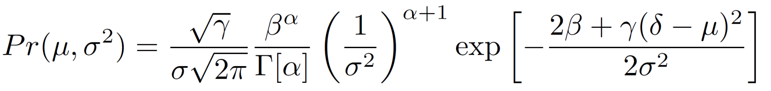
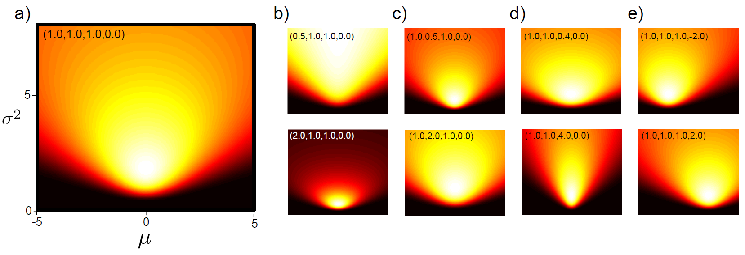
Normal Inverse Gamma Distribution
Defined on 2 variables μ and σ²>0
or for short
Four parameters α, β, γ > 0 and δ.

Slide 14
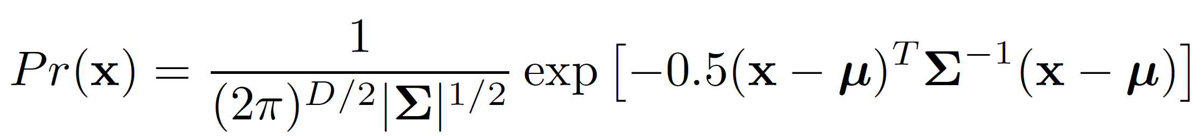
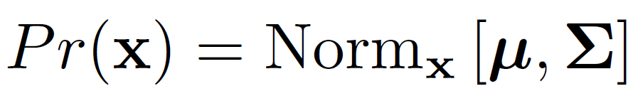

Multivariate Normal Distribution
For short we write:
Multivariate normal distribution describes multiple continuous variables. D is the number of dimensions. Takes 2 parameters
a vector containing mean position, μ
a symmetric “positive definite” covariance matrix Σ
Positive definite: is positive for any real

Slide 15
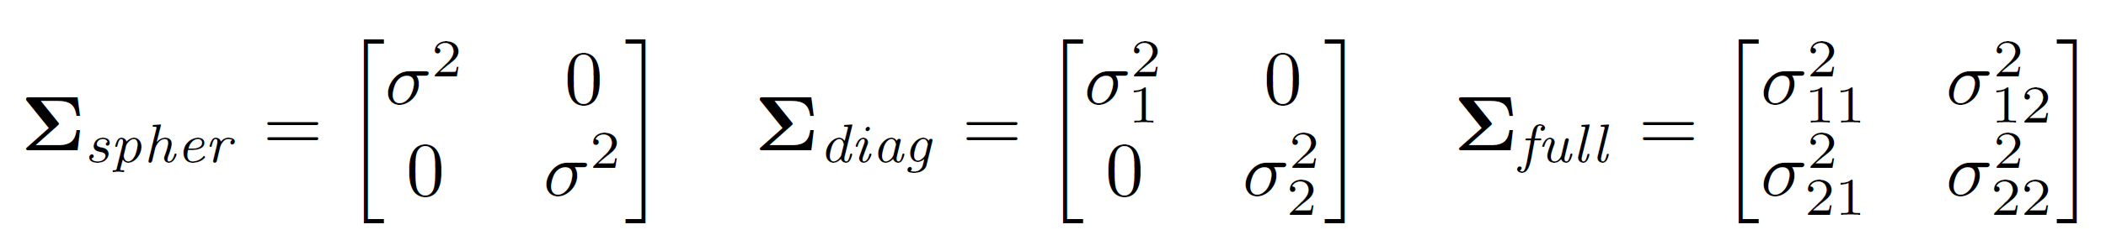
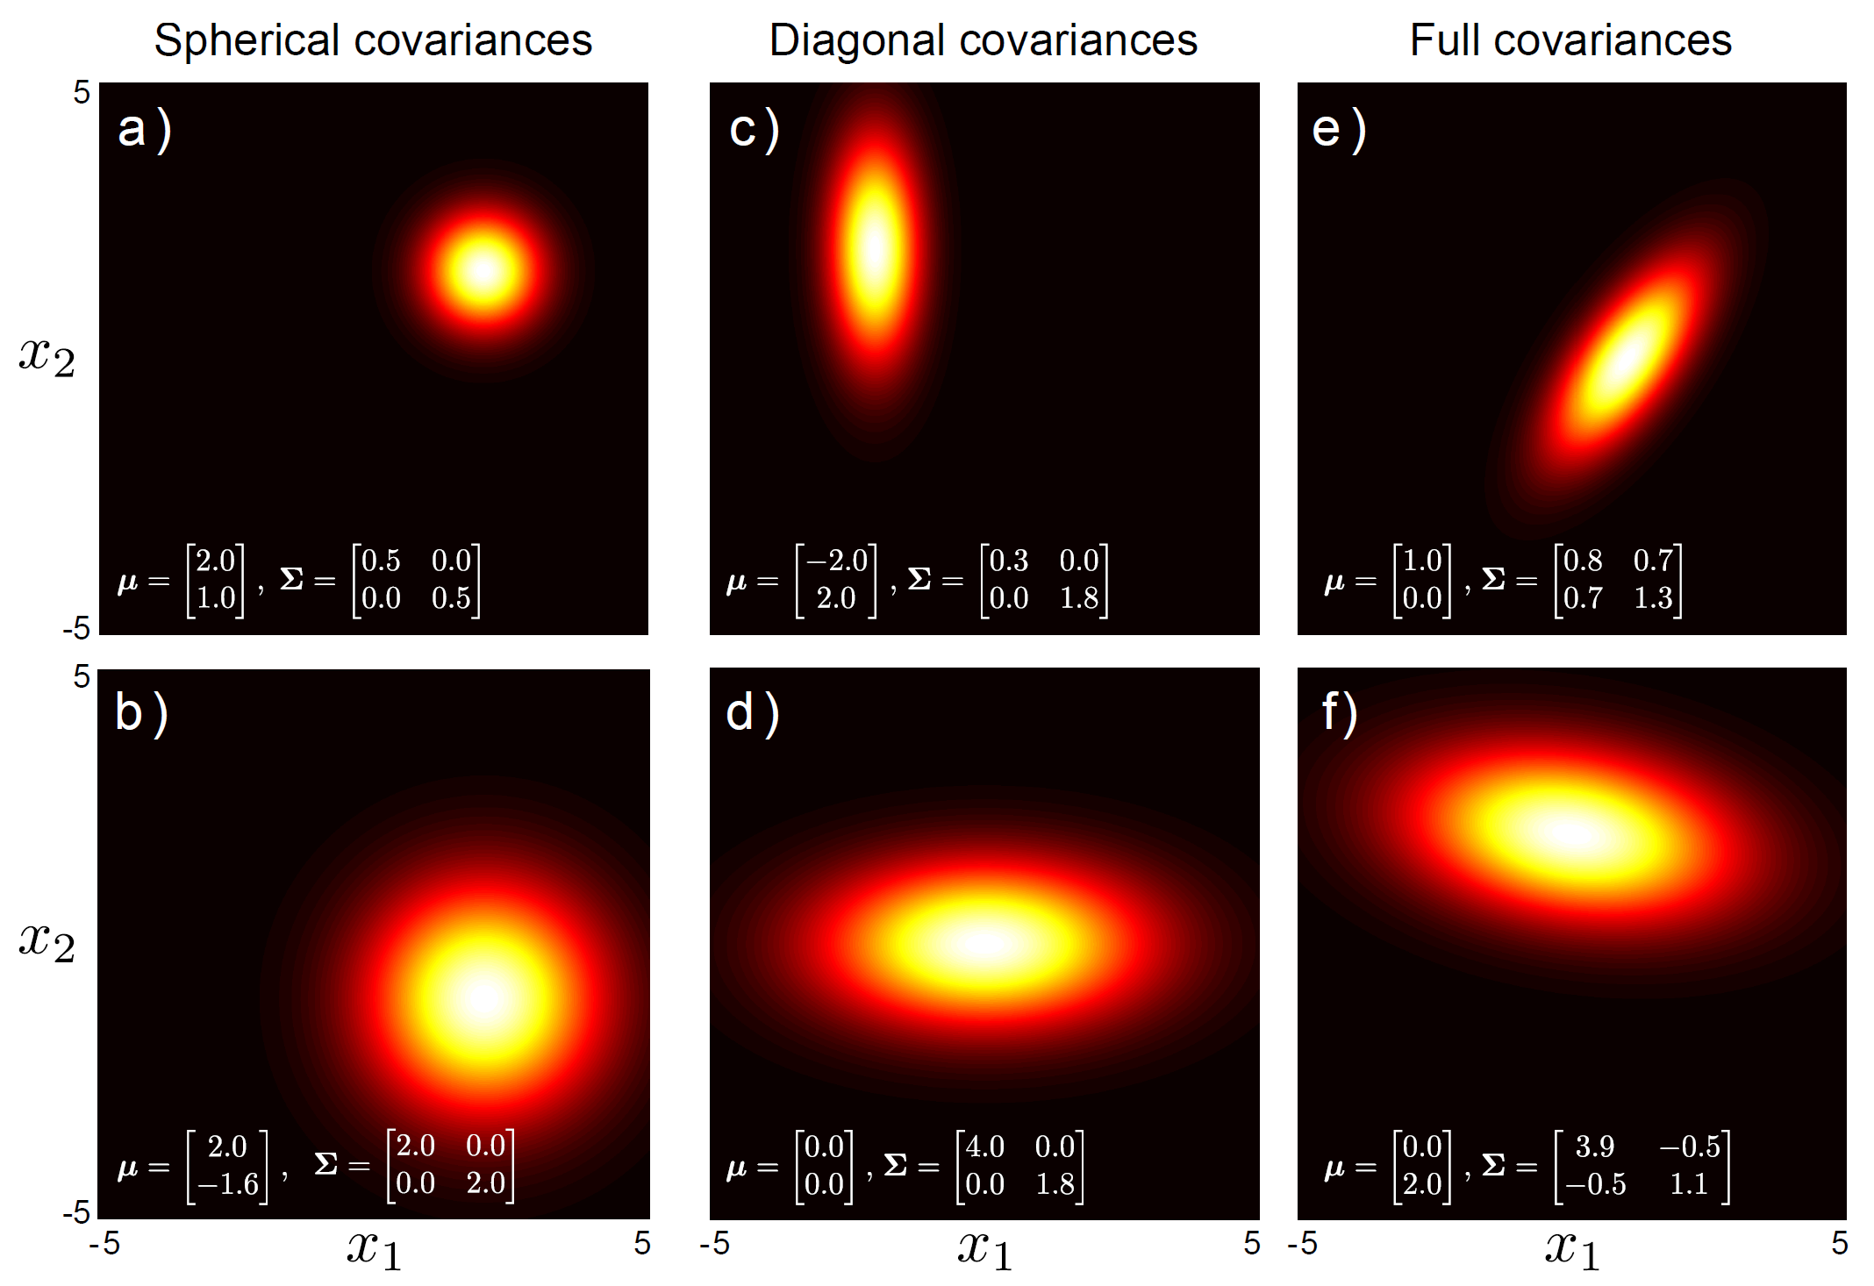
Types of covariance
Covariance matrix has three forms, termed spherical, diagonal and full

Slide 16
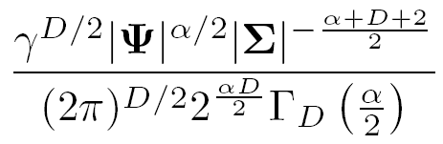
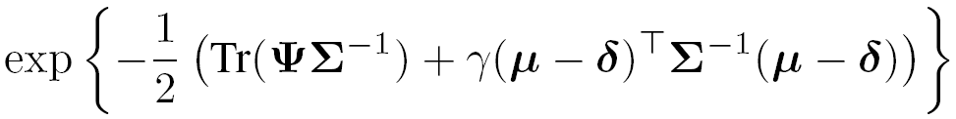
Normal Inverse Wishart
Defined on two variables: a mean vector μ and a symmetric positive definite matrix, Σ.
Corrected, vs. book version
or for short:
Has four parameters
a positive scalar, α
a positive definite matrix Ψ
a positive scalar, γ
a vector δ

Slide 17
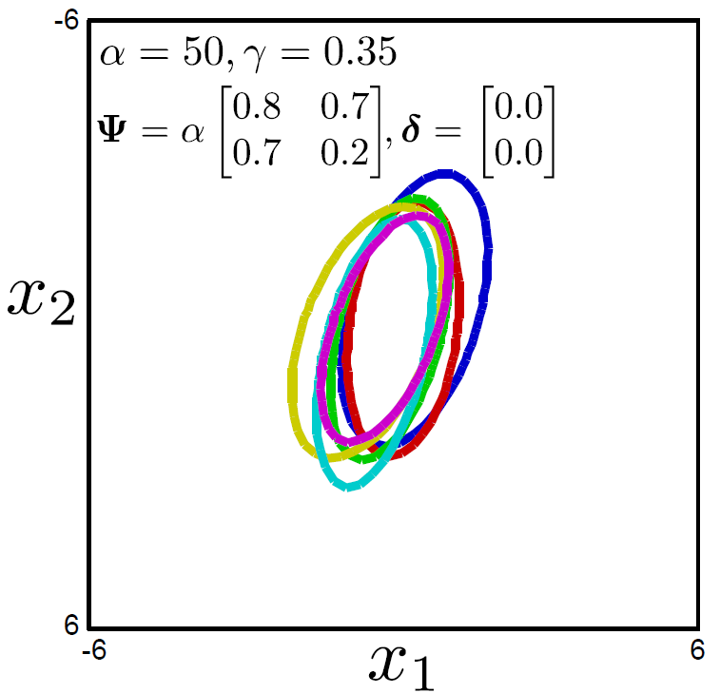
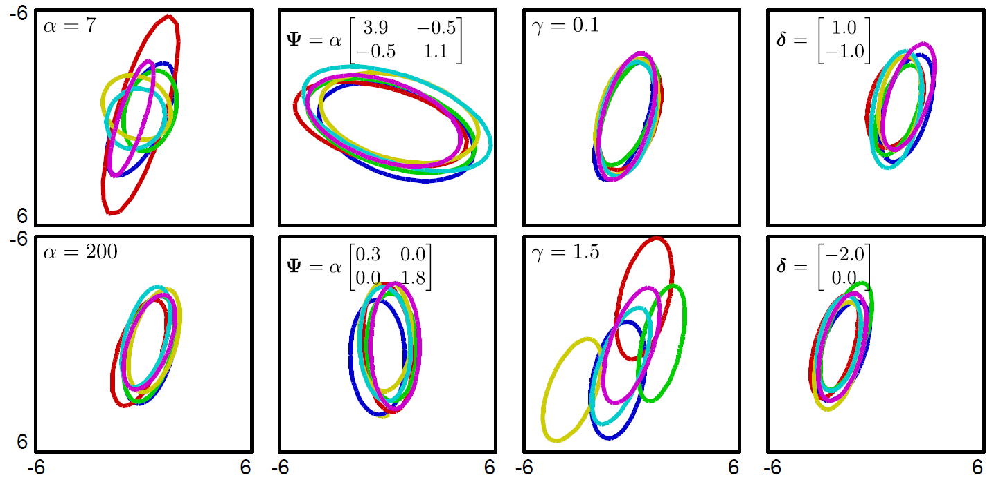
Samples from Normal Inverse Wishart
(dispersion)
(ave. Covar)
(disper of means)
(ave. of means)

Slide 18
Conjugate Distributions
The pairs of distributions discussed have a special relationship: they are conjugate distributions
Beta is conjugate to Bernoulli
Dirichlet is conjugate to categorical
Normal inverse gamma is conjugate to univariate normal
Normal inverse Wishart is conjugate to multivariate normal

Slide 19
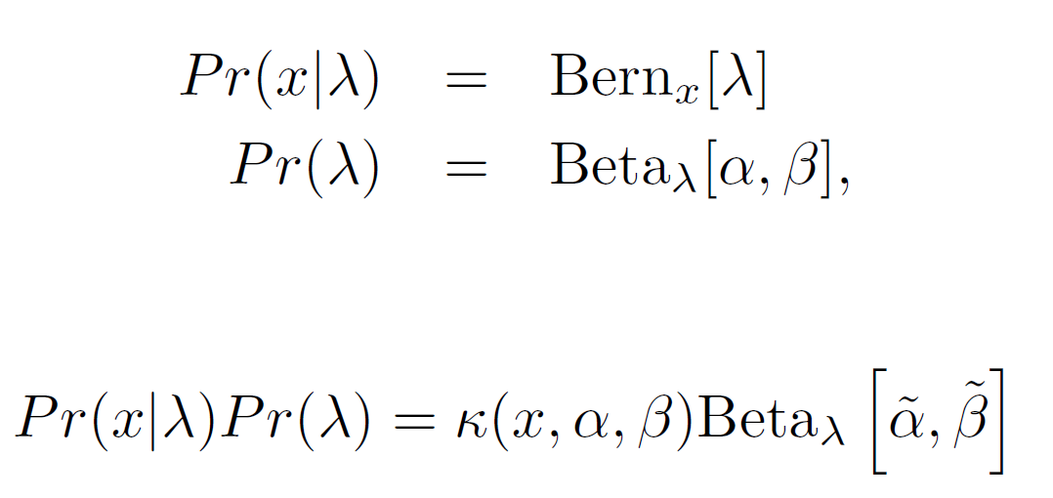
Conjugate Distributions
When we take product of distribution and its conjugate, the result has the same form as the conjugate.
For example, consider the case where
then
a constant
A new Beta distribution

Slide 20
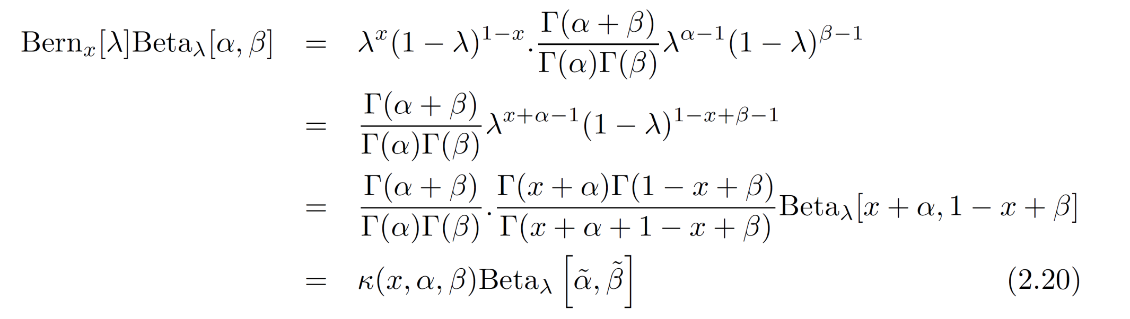
Example proof
When we take product of distribution and it’s conjugate, the result has the same form as the conjugate.
Computer vision: models, learning and inference. ©2011 Simon J.D. Prince
20

Slide 21
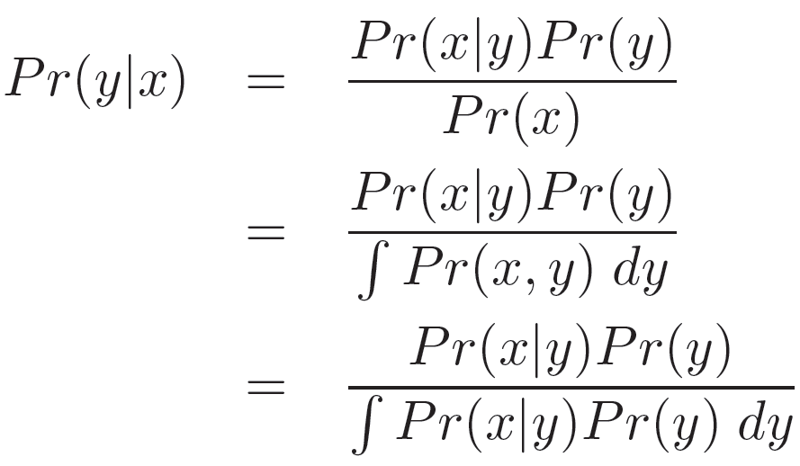
Bayes’ Rule Terminology
Likelihood – propensity for observing a certain value of x given a certain value of y
Prior – what we know about y before seeing x
Evidence – a constant to ensure that the left hand side is a valid distribution
Posterior – what we know about y after seeing x

Slide 22
Importance of the Conjugate Relation 1
Choose prior that is conjugate to likelihood
Learning parameters:
2. Implies that posterior must have same form as conjugate prior distribution
3. Posterior must be a distribution which implies that evidence must equal constant κ from conjugate relation

Slide 23
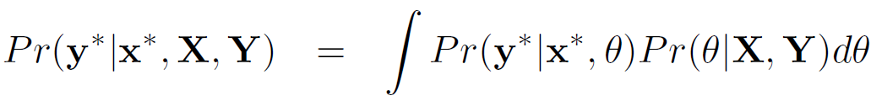
Importance of the Conjugate Relation 2
Marginalizing over parameters
2. Integral becomes easy --the product becomes a constant times a distribution
Integral of constant times probability distribution
= constant times integral of probability distribution = constant x 1 = constant
1. Chosen so conjugate to other term

Slide 24
Conclusions
Presented four distributions which model useful quantities
Presented four other distributions which model the parameters of the first four
They are paired in a special way – the second set is conjugate to the other
In the following material we’ll see that this relationship is very useful

